Slide 1

Predicting fraud in financial payments

Slide 2
Project Created by-
Sagar Sen
MCA 2nd Semester
ID- 191001270007
Guided By-
AB Choudhury(HoD)

Slide 3
Work Recap
Explore the data
Cleaning the data
Feature engineering
Data visualization
Machine learning
conclusions

Slide 4
Introduction
This dataset is taken from IRIS DATASET with information on the rising risk of digital financial fraud, emphasizing the difficulty in obtaining such data. The main technical challenges it poses to predicting fraud is the highly imbalanced distribution between positive and negative cases in 6 Million rows of data. Another stumbling block to the utility of this data stems from the possible discrepancies in its description. The goal of this analysis is to solve both these issues by a detailed data exploration and cleaning followed by a suitable machine learning algorithm to deal with the skew. I show that an optimal solution based on feature engineering and extreme gradient- boosted decision trees yield an enhanced predictive power of 0.997, as measured by the area under the precision-recall curve. Crucially these results were obtained without artificial balancing of the data making this approach suitable to real world applications.

Slide 5
OUTLINE
Import
Explore the data
Data cleaning
Feature engineering
Data visualization
Machine learning to detect the fraud
Conclusions

Slide 6
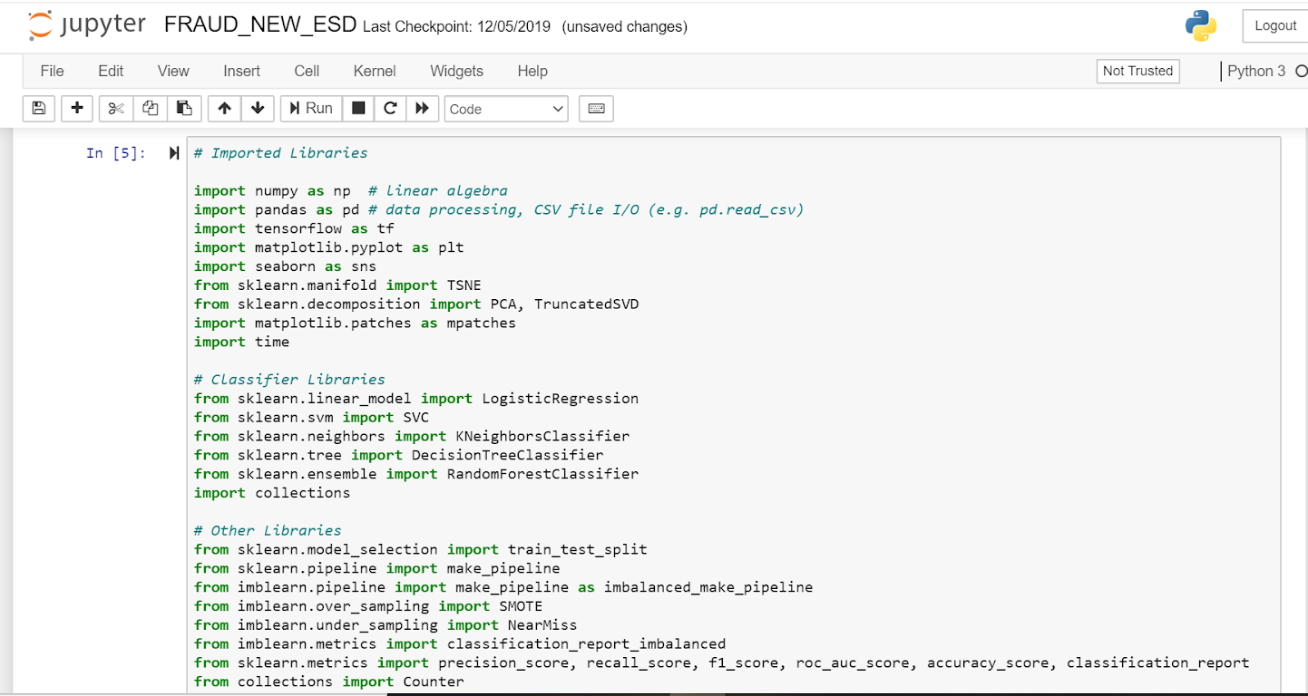
Import the data

Slide 7
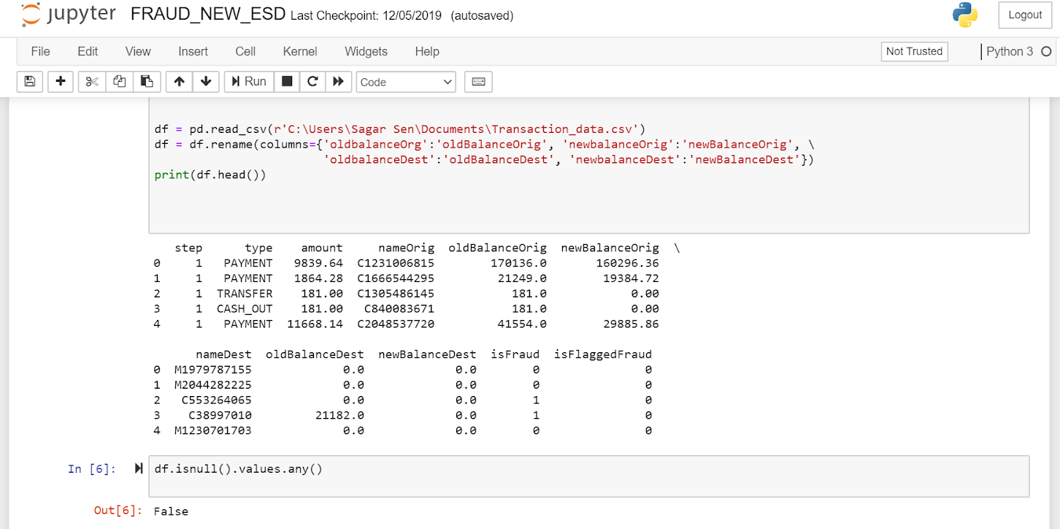
We then make corrections of the Column names

Slide 8
Explore the data
We will wrangle the data using data frames and will then explore the data. The data which will be fraudulent and which are not are to be discussed here.
Which types of data are Fraudulent?
We find that there are 5 types of transactions upon which we find that 2 are “ TRANSFERS ” and “ CASH OUT ”. “ TRANSFER ” where money is sent to a customer and “ CASH OUT “ where money is sent to a merchant who pays the customer in cash. Remarkably the number of fraudulent TRANSERs almost equals to the number of CASH_OUTS.

Slide 9
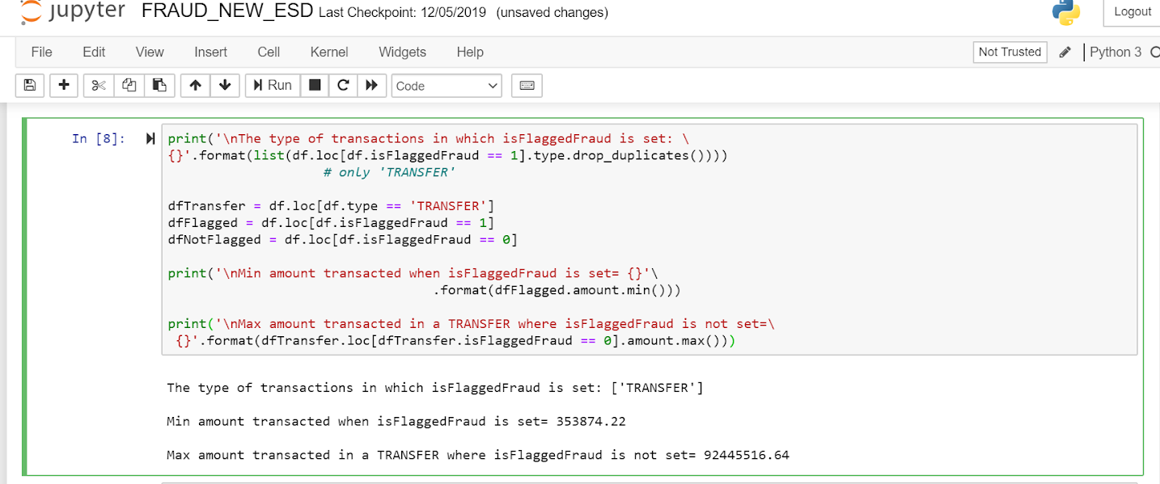
The no of Fraudulent transactions are counted below

Slide 10
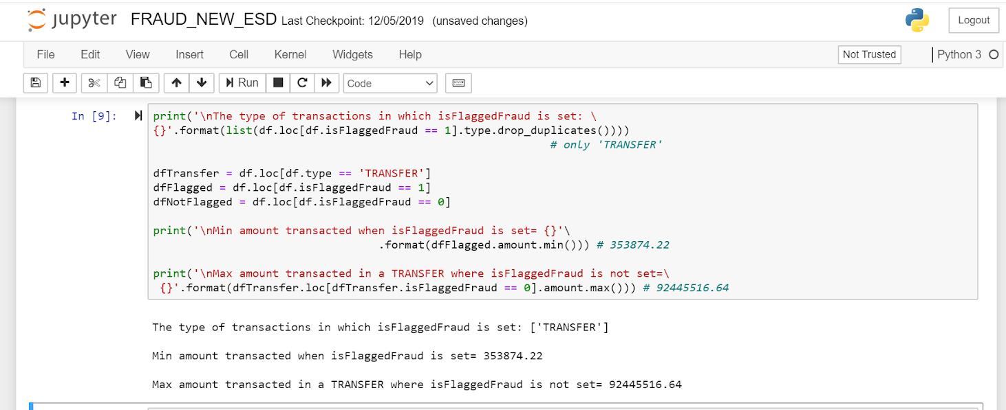
What determines whether the feature isFlaggedFraud gets set or not
It turns out that the feature isFlaggedFraud is somewhat unclear, out of 16 entries (6 million) where the isFlaggedFraud feature is set do not seem to correlate with any explanatory variable. The data isFlaggedFraud is set to make sure that “ TRANSFER “ an amount greater than 200,000. In fact as shown below, isFlaggedFraud can remain not set despite this condition being met.

Slide 11
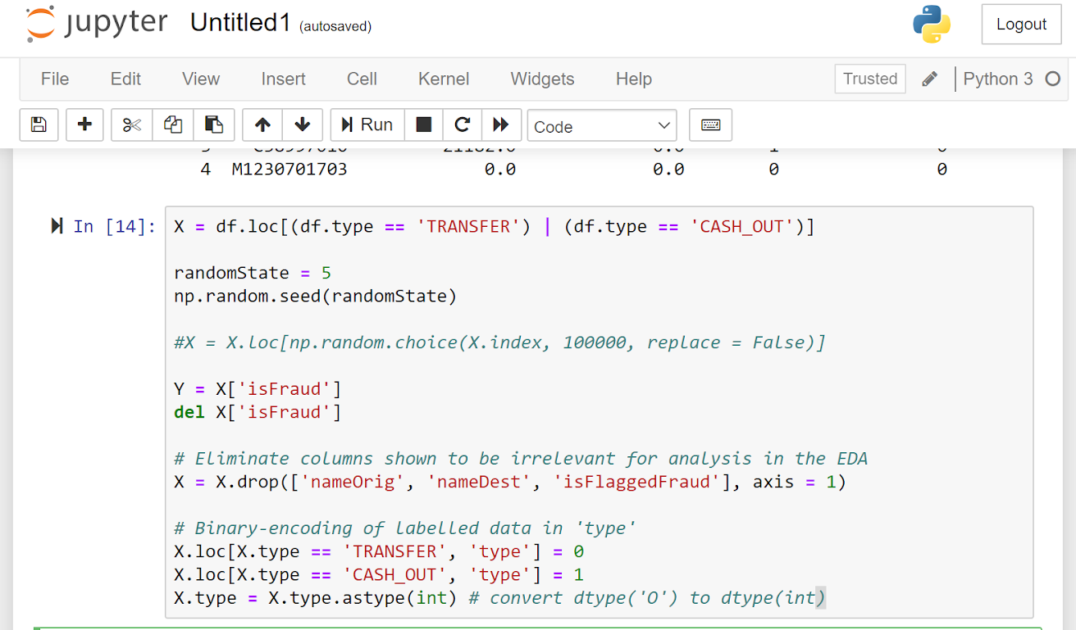
Data Cleaning
From the exploratory data analysis (EDA) we know that fraud only occurs in “ TRANSFER “ and “ Cash_Out’s “. so we assemble only the corresponding data in X for analysis.

Slide 12
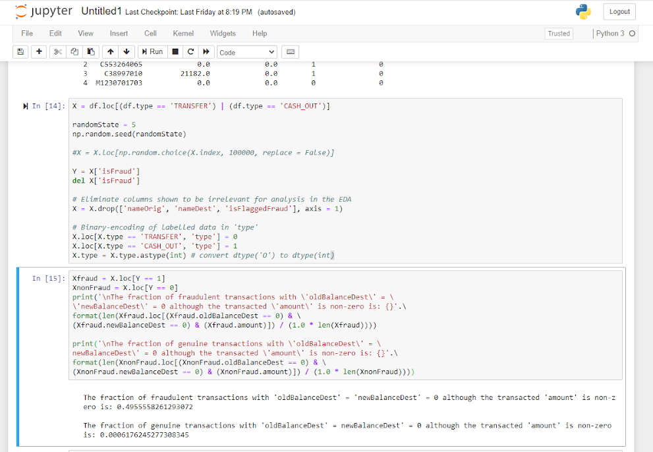
Imputation of Latent Missing values
The data has several transactions with Zero balances in the destination account both before and after a non-zero amount is transacted. The fraction of such transaction, where zero likely denotes a missing value, is much larger in fraudulent (50%) compared to genuine transactions (0.06%).

Slide 13
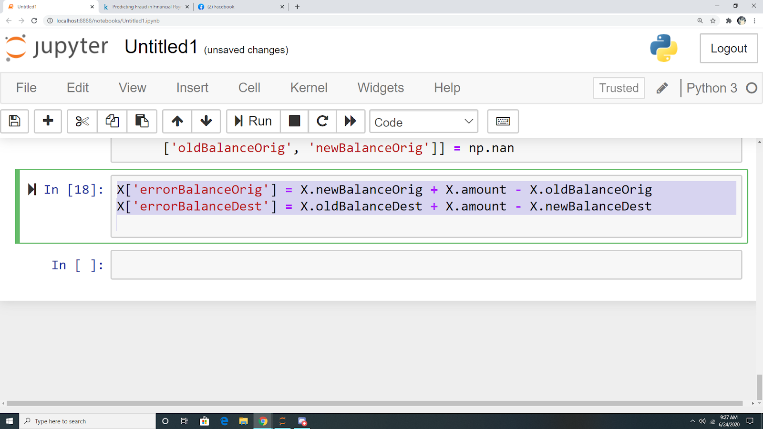
Feature engineering
Motivated by the possibility of zero-balances serving to differentiate between fraudulent and genuine transactions we take the data-imputation a step further and create 2 new feature(COLUMNS) recording errors in the originating and destination accounts for each transaction. These new features turn out to be important in obtaining the best performance from the ML algorithm that we will finally use.

Slide 14
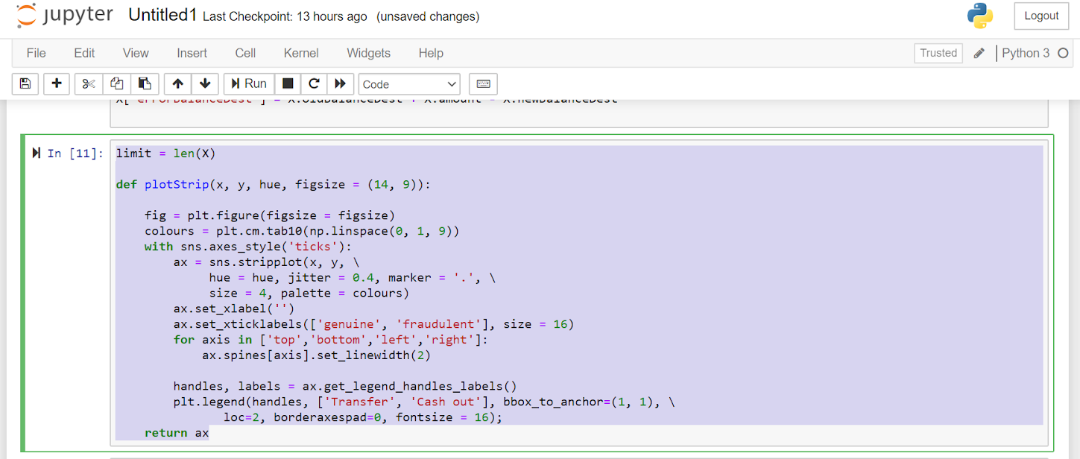
Data visualization
The best way of confirming that the data contains enough information so that a ML algorithm can make strong predictions, is to try and directly visualize the differences between fraudulent and genuine transactions. Motivated bu this principle, i visualize these differences in several ways in the plots below.

Slide 15
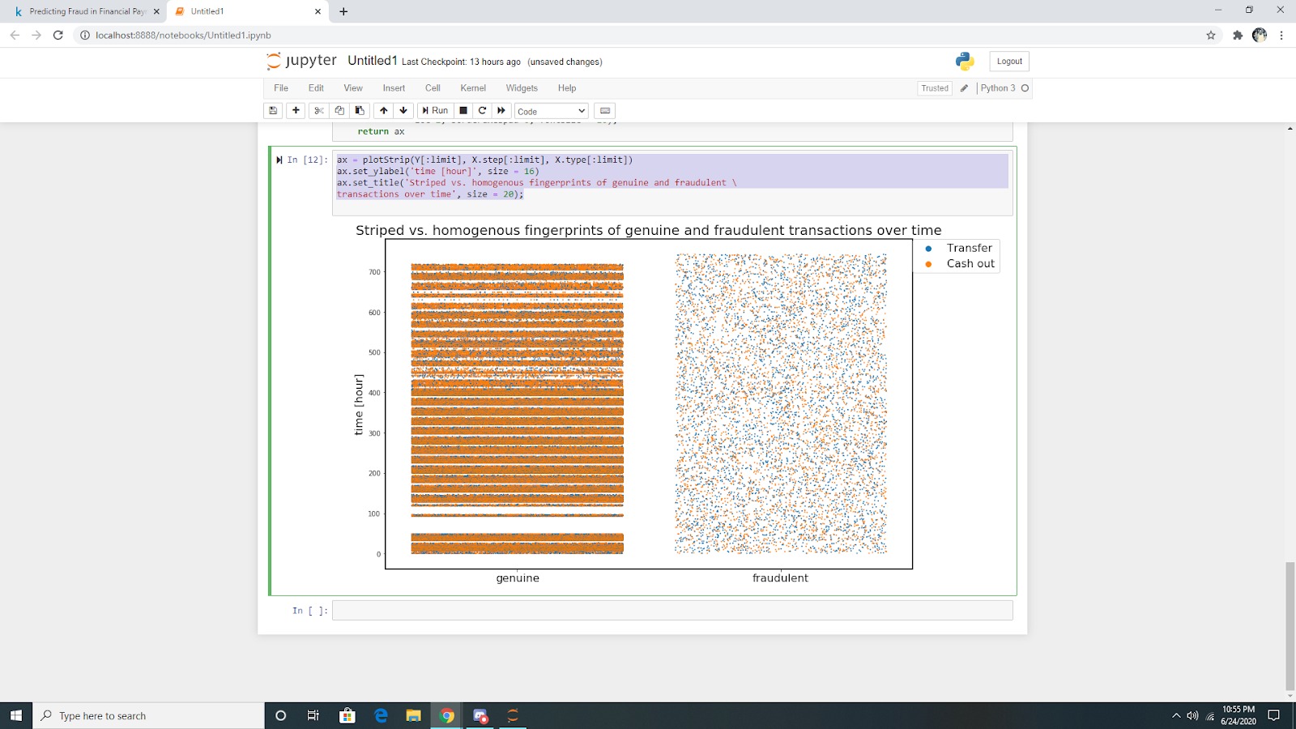
Dispersion over time
The plot below shows how the fraudulent and genuine transactions yield different fingerprints when their dispersion is viewed over time. It is clear that fraudulent transactions are more homogeneously distributed over time compared to genuine transactions. Also apparent is that CASH_OUT outnumber TRANSFER in genuine transactions in contrast to a balanced distribution between them in fraudulent transactions. Note that the width of each ‘fingerprint’ is set by the ‘jitter’ parameter in the plotStrip function above which attempts to separate out and plot transaction occurs at the same time with different abscissae.

Slide 16
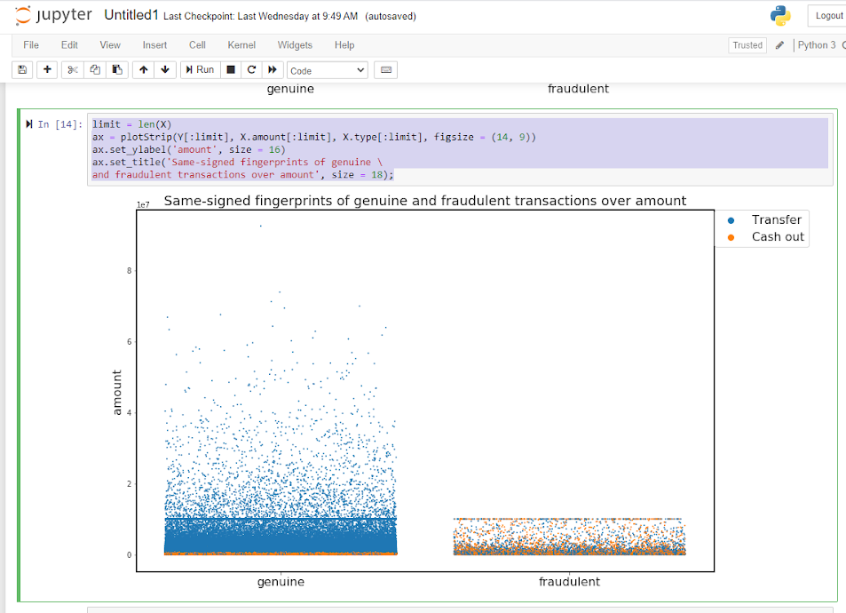
Dispersion over amount
The two plots below show that although the presence of frauding a transaction can be discerned by the original amount feature, the new errorBalanceDest feature is more effective at making a distinction.

Slide 17
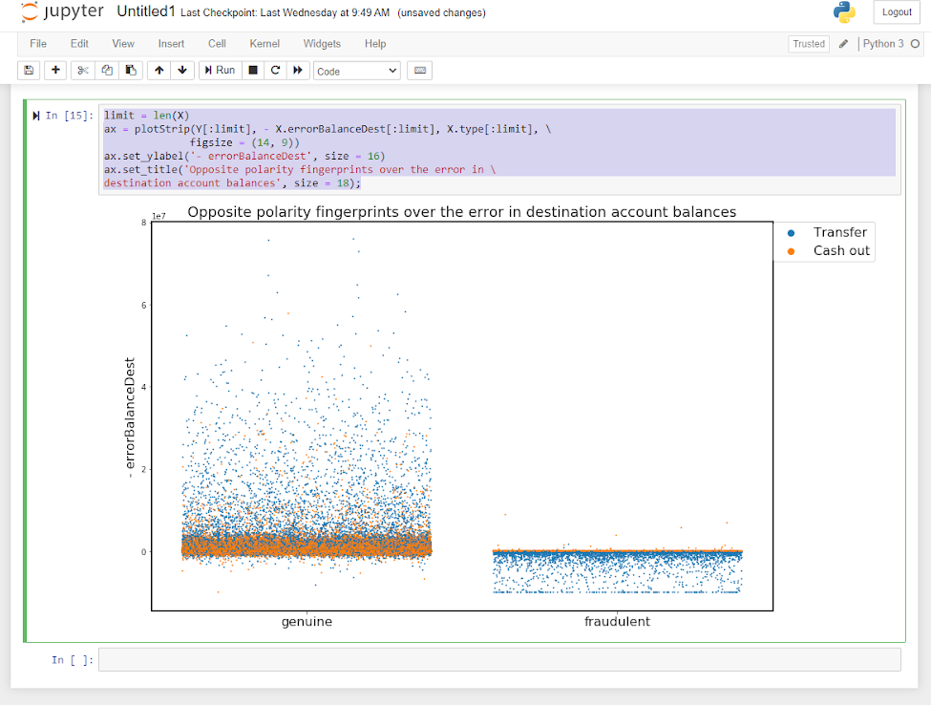
Dispersion over error in balance in destination accounts

Slide 18
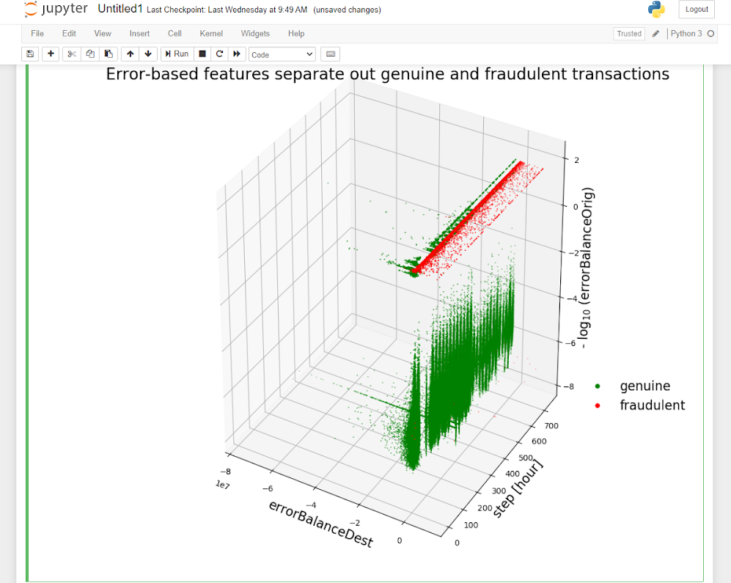
Separating out genuine from fraudulent transactions
The 3D plot below distinguishes best between fraud and non-fraud data by using both of the engineered error based features. Clearly the original step feature is ineffective in separating out fraud. Note the striped nature of the genuine data vs time which was anticipated from the fig. Below

Slide 19
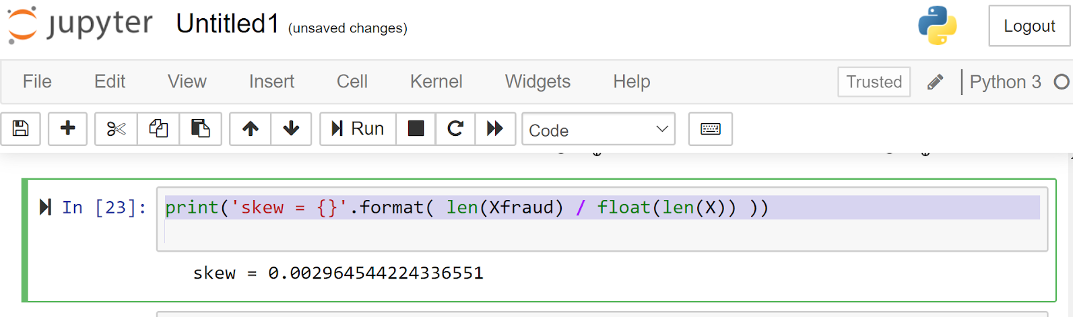
Machine learning to detect Fraud in skewed Data
Having obtained evidence from the plots above that the data now contains features that make fraudulent transactions clearly detectable, the remaining obstacle for trainng a robust ML model is the highly imbalanced nature of the data.

Slide 20
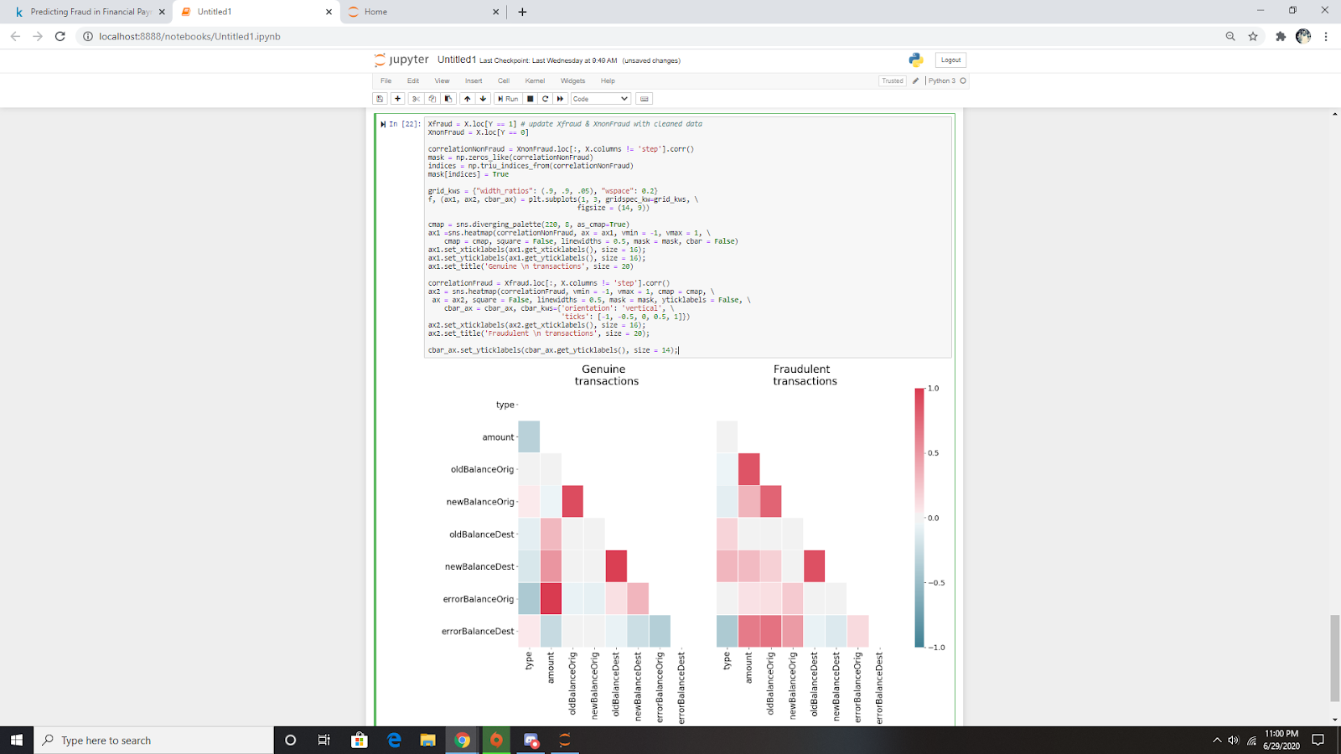
Fingerprints of Genuine and Fraud Transactions
Smoking guns and comprehensive evidence embedded in the dataset of the difference between fraudulent and genuine transactions is obtained by examining their respective correlations in the heatmaps below.

Slide 21
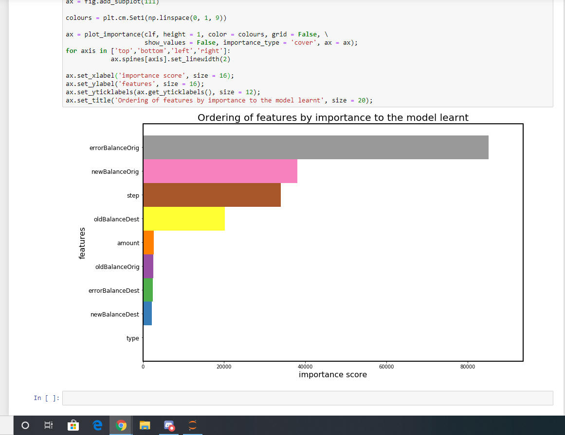
What are the important features of ML models
The figure below shows that the new feature errorBalanceOrig that we created is the most relevant feature for the model. The features are ordered based on the number of samples affected by splits on those features.

Slide 22
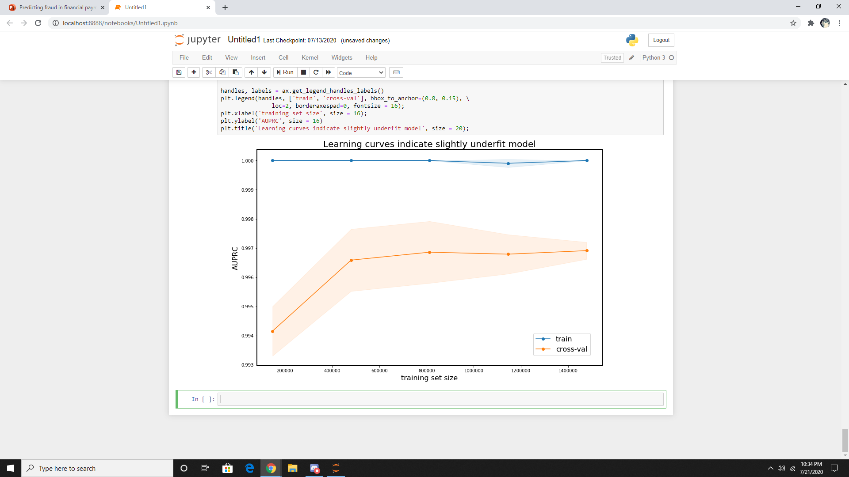
Bias- variance tradeoff
The model we have learnt has a degree of bias and is slighly underfit. This is indicated by the levelling in AUPRC as the size of the training set is increased in the cross-validation curve below. The easiest way to improve the performance of the model still further is to increase the max_depth parameter of the XGBClassifier at the expense of the longer time spent learning the model. Other parameters of the classifier that can be adjusted to correct for the effect of the modest underfitting include decreasing min_child_weight and decreasing reg_lambda.

Slide 23
Conclusion
We thoroughly interrogated the data at the outset to gain insight into which features could be discarded and those which could be valuably engineered. The plots provided visual confirmation that the data could be indeed be discriminated with the aid of the new features. To deal with the large skew in the data, we chose an appropriate metric and used an ML algorithm based on an ensemble of decision trees which works best with strongly imbalanced classes. The method used in this kernel should therefore be broadly applicable to a range of such problems.

